Slide 1
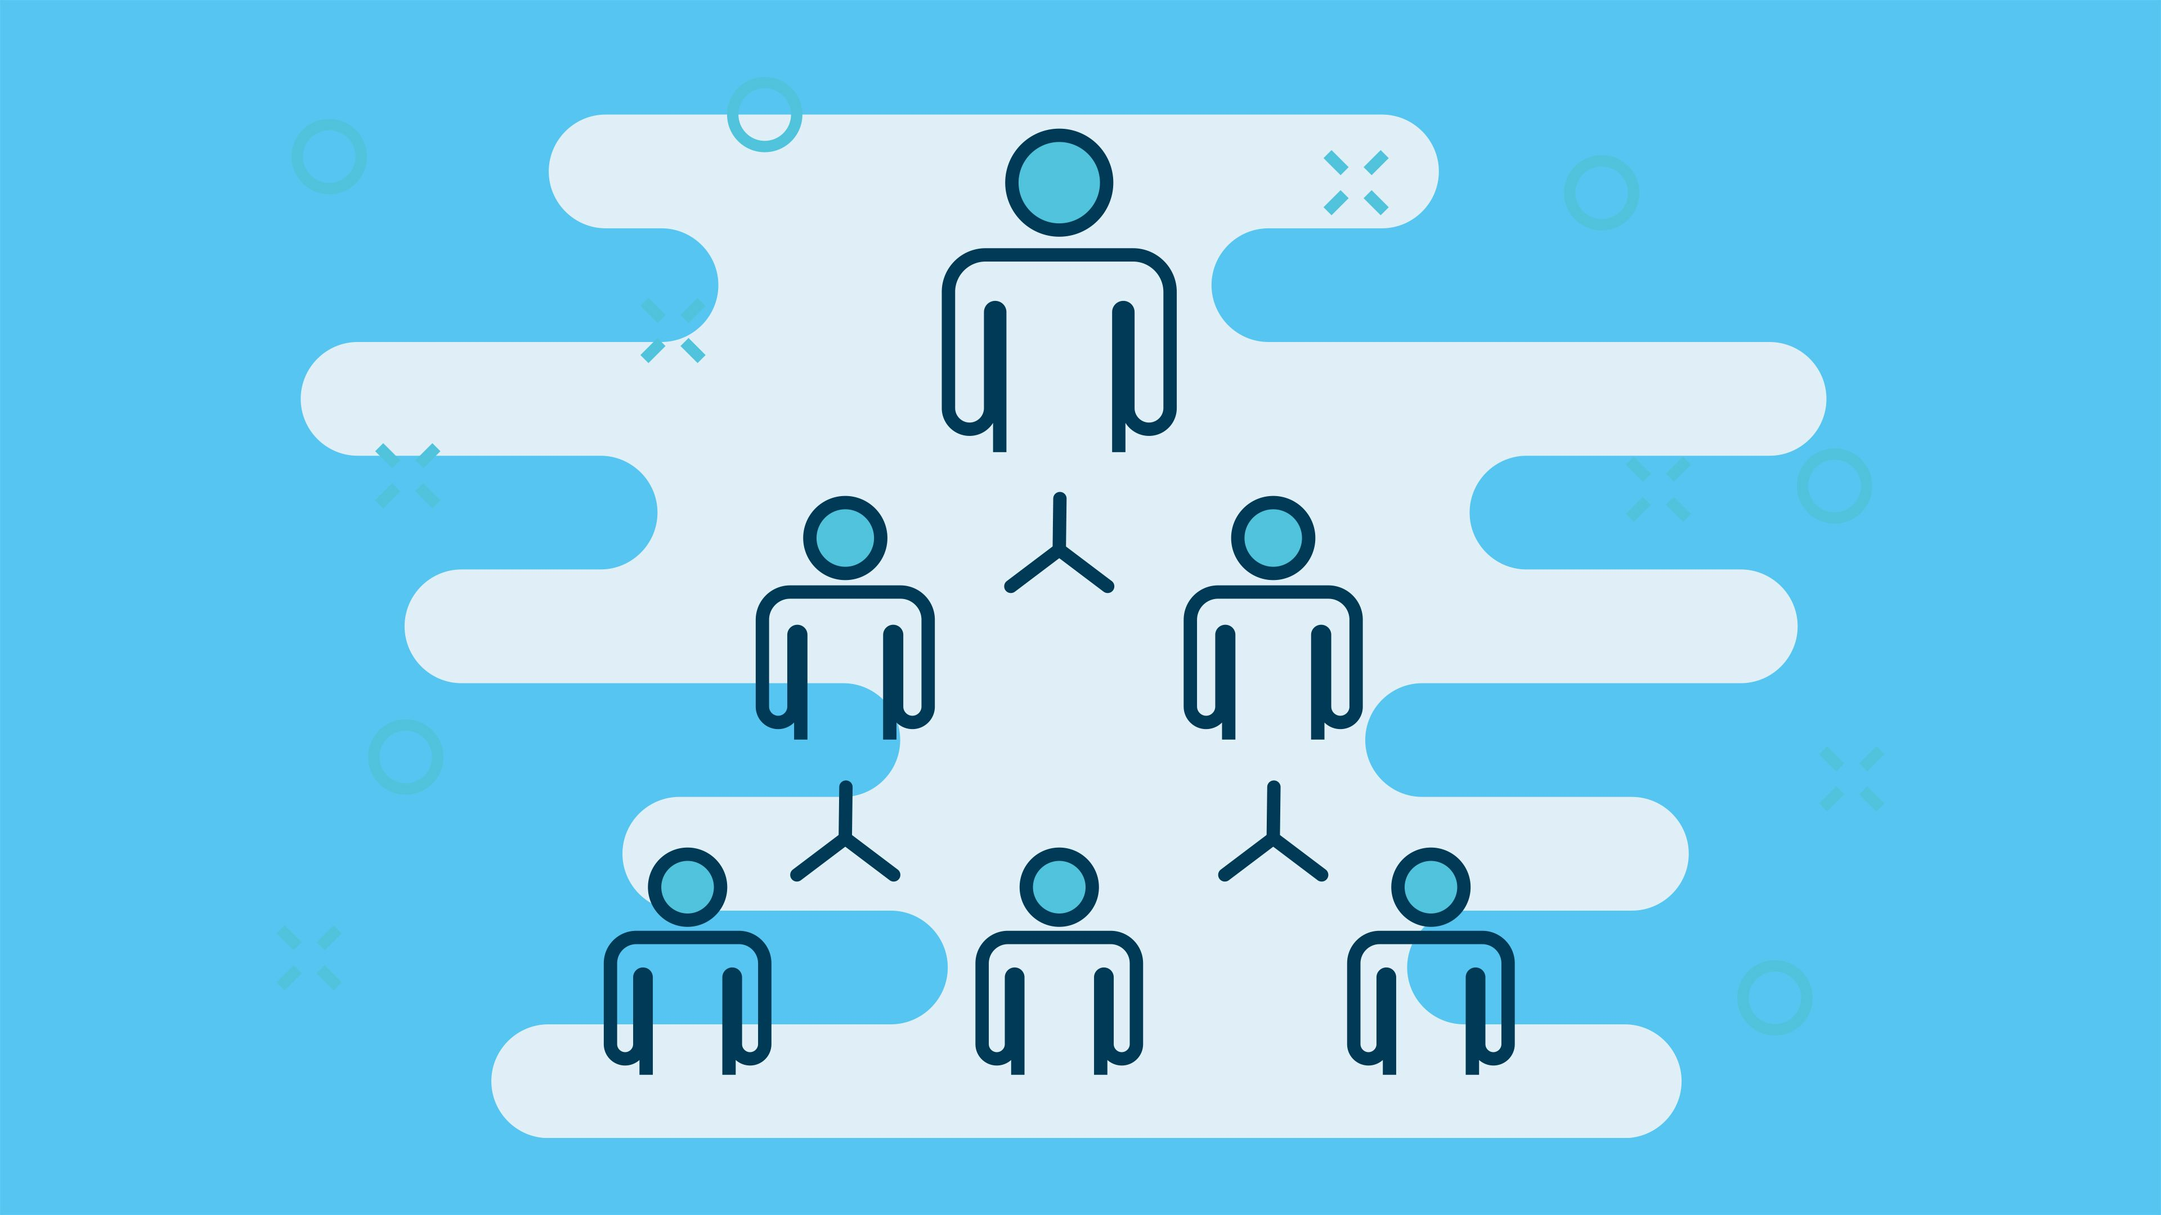
Organization Structure
And Design

Slide 2
Organizing: Concept
When the organization’s goals and plans are in place, the organizing function sets in motion the process of seeing that those goals and plans are pursued.
When managers organize, they are defining what work needs to be done and creating a structure that enables those work activities to be completed efficiently and effectively.
Organizing is the process of arranging and structuring work to accomplish organizational goals.

Slide 3
Purposes of organizing
Divides work to be done into specific jobs and departments.
Assign tasks and responsibilities associated with individual jobs.
Coordinates diverse organizational tasks.
Clusters jobs into units.
Establishes relationships among individuals, groups and departments.
Establishes formal lines of authority.
Allocates and deploys organizational resources.

Slide 4
Organizational Structure
Organizational structure is the formal arrangement of jobs within the organization.
It is the framework of roles, responsibilities, communication channels, and authority within an organization.
It defines how tasks are divided, coordinated, and controlled to achieve the organization's goals.

Slide 5
Organizational Design
When managers create or change the structure, they are engaged in organizational design.
Organizational design is the process that involves decision about six key elements:
Work specialization
Departmentalization
Chain of command
Span of control
Centralization and decentralization
Formalization

Slide 6
Elements of Organizational Design
Work Specialization
The degree to which tasks in the organization are divided into separate jobs with each step completed by different person.
Overspecialization may result in boredom, stress, poor quality, increased absenteeism and increased turnover.
Departmentalization
Departmentalization is the process of organizing a business or other entity into separate units or departments based on certain criteria.
This division helps streamline operations, improve communication, and facilitate management within the organization.

Slide 7
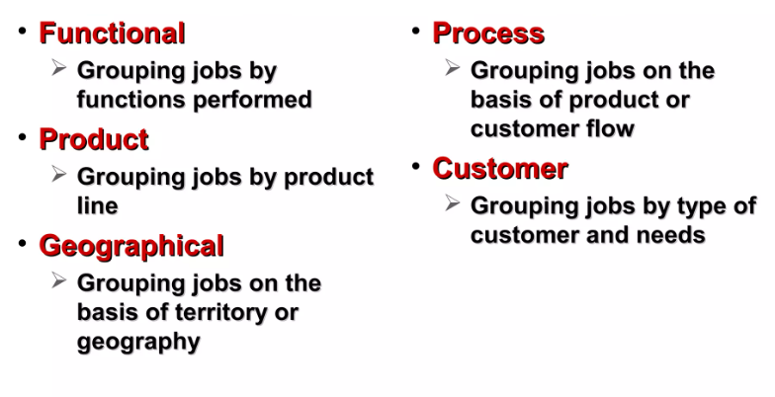
Types of Departmentalization

Slide 8
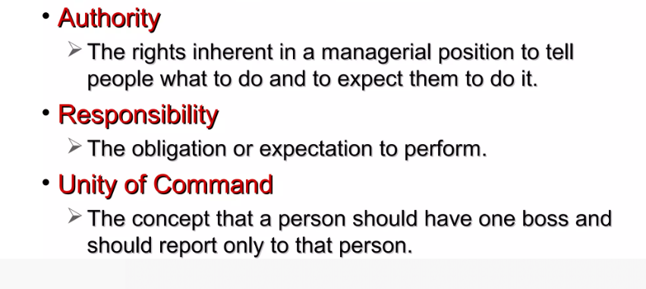
Chain of Command
The continuous line of authority extending from upper organizational levels to lower levels, which clarifies who reports to whom.

Slide 9
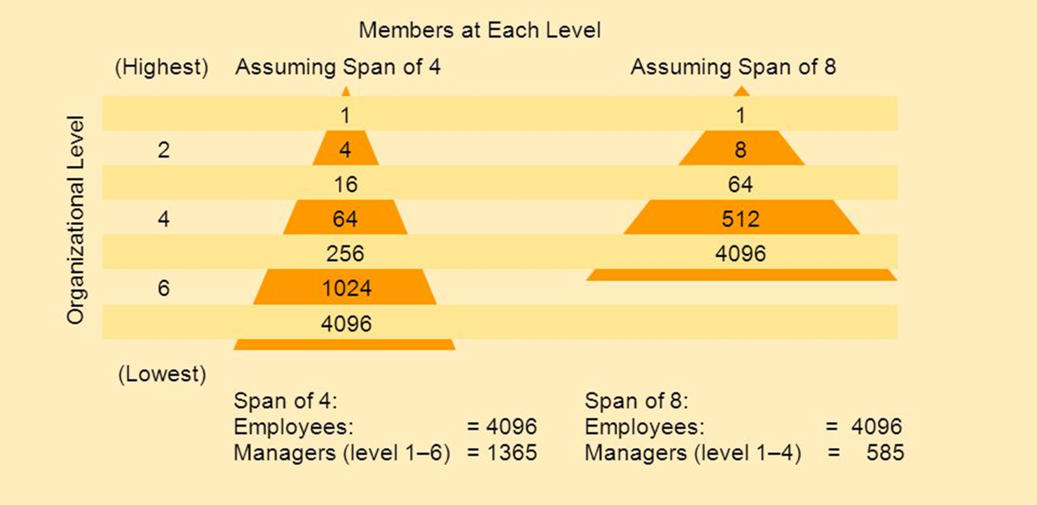
Span of control
It refers to the number of employees who can be effectively and efficiently supervised by a manager.

Slide 10
Centralization and decentralization
Centralization refers to the degree to which decision making takes place at upper levels of the organization.
If top managers make key decisions with little input from below, then the organization is more centralized.
Decentralization refers to the degree to which lower level employees provide input or actually make decisions.

Slide 11
Formalization
It refers to how standardized an organization’s jobs are and the extent to which employee behaviour is guided by rules and procedures.
In highly formalized organizations, there are explicit job descriptions, numerous organizational rules and clearly defined procedures covering work processes.
Employees have little discretion over what’s done, when it’s done and how it’s done.

Slide 12
Building the vertical dimension of organizations
The vertical dimension of organizations refers to the hierarchical structure and levels of authority within the organization.
A vertical organization structure is characterized by a hierarchical chain of command, where managers are responsible for directing and controlling their subordinates' work.
It involves the arrangement of roles, responsibilities, and reporting relationships from top management to lower levels. Here's how to build the vertical dimension effectively:
Clear Organizational Structure: Establishing a clear organizational structure ensures that everyone understands their roles, responsibilities, and who they report to. This clarity fosters efficiency and accountability.
Hierarchy of Authority: Define clear lines of authority and decision-making processes. This helps prevent confusion and ensures that decisions are made effectively and in a timely manner.

Slide 13
Building the vertical dimension of organizations
3. Delegation of Authority: Empower employees by delegating authority appropriately. This not only relieves the burden on top management but also fosters employee development and engagement.
4. Communication Channels: Establish open and effective communication channels between different levels of the organization. This promotes transparency, feedback, and alignment with organizational goals.
5. Performance Management: Implement performance management systems to evaluate and reward employees based on their contributions to organizational goals. This encourages accountability and motivates employees to perform at their best.

Slide 14
Building the horizontal dimension of organizations
A horizontal organization structure is characterized by a flat management hierarchy where there are few managers overseeing many employees.
In this structure, employees are empowered to make decisions without constant managerial approval.
It involves breaking down silos and promoting synergy among various teams.
Here's how to build the horizontal dimension effectively:
Cross-Functional Teams: Form cross-functional teams composed of members from different departments or disciplines to work together on specific projects or initiatives. This promotes collaboration and innovation.
Shared Goals and Objectives: Align the goals and objectives of different departments with the overall strategic objectives of the organization. This ensures that everyone is working towards the same overarching goals.

Slide 15
Building the horizontal dimension of organizations
3. Interdepartmental Communication: Encourage open communication and information sharing among different departments. This helps break down silos and fosters a culture of collaboration and knowledge sharing.
4. Integrated Processes: Streamline and integrate processes across departments to eliminate inefficiencies and redundancies. This enhances productivity and improves the overall effectiveness of the organization.
5. Conflict Resolution Mechanisms: Establish effective mechanisms for resolving conflicts and addressing disagreements that may arise between different departments. This ensures that issues are addressed promptly and constructively.

Slide 16
Departmentalization methods in horizontal structures include
A. Functional (grouping by functions or expertise)
B. Divisional (grouping by products, regions, or customer segments) an
C. Matrix (combining multiple structures for flexibility).

Slide 17
A. Functional (grouping by functions or expertise)
A functional structure is an organizational design that divides the organization into departments or units based on their specific functions or roles.
Each department is headed by a functional manager who typically has expertise and experience in the functions they oversee.
Employees are grouped within these departments based on their roles and responsibilities.
This structure is known for its efficiency in allowing employees to use their skills effectively within their specialized areas of expertise.
Amazon, Apple follow this structure.

Slide 18
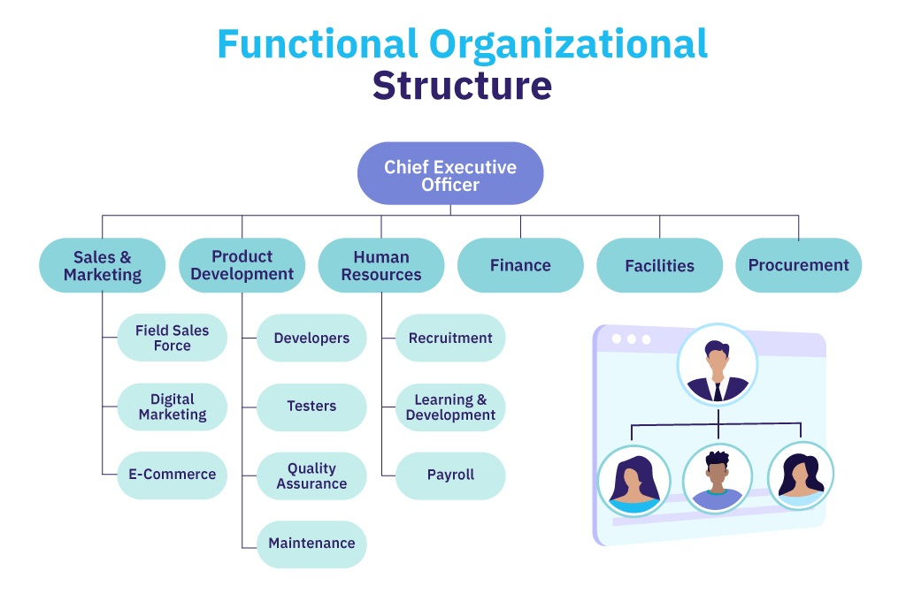

Slide 19
B. Divisional (grouping by products, regions, or customer segments)
A divisional organizational structure is a design that groups different organizational functions into distinct divisions, often based on product lines, geographic regions, or other criteria.
Each division operates independently and contains all the resources and functions needed to support its specific product line or geographical area.
This structure facilitates specialization and focus within each division, including dedicated finance, IT, and marketing departments, enabling more effective management of diverse products or markets.
McDonald’s, Disney follow this structure.

Slide 20
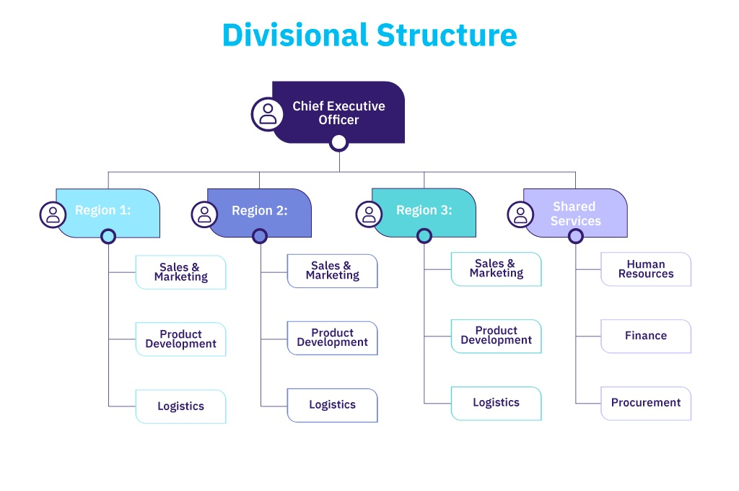

Slide 21
C. Matrix (combining multiple structures for flexibility)
A matrix organizational structure is a workplace arrangement where employees report to two or more managers simultaneously, rather than having a single manager overseeing their work.
In this structure, employees may have a primary manager to whom they report regularly, but they also work under one or more project managers for specific projects or tasks.
This dual reporting system allows for greater flexibility and collaboration, particularly in complex and dynamic work environments.
Nike, Phillips follow this organization structure.

Slide 22
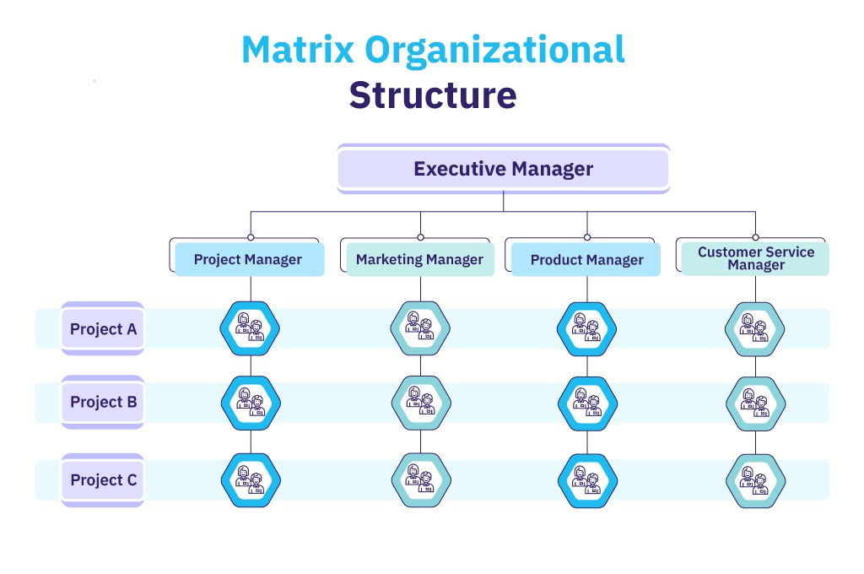

Slide 23
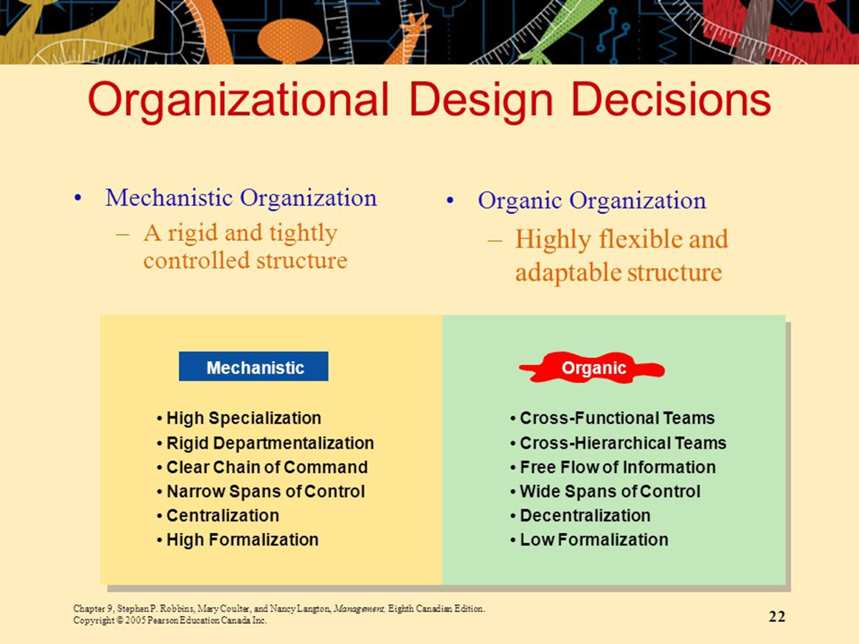
The contingency approach to organization design
Firstly, lets understand about two types of organizational designs:

Slide 24
The contingency factors
1. Strategy and structure
An organization’s structure should facilitate goal achievement.
Flexibility and free-flowing information of the organic structure works well when an organization is pursuing meaningful and unique innovations.
The mechanistic structure, with its efficiency, stability and tight controls, works best for companies that want to tightly control costs.
2. Size and structure
Large organizations- typically considered to be those with more than 2,000 employees tend to have more specialization, departmentalization, centralization and rules and regulations than do small organizations.

Slide 25
The contingency factors
3. Technology and structure
Research studies shows that, organizations adapt their structures to their technology depending on how routine their technology is for transforming inputs into outputs.
In general, the more routine the technology, the more mechanistic the structure can be, and the organizations with more non routine technology are more likely to have organic structures.
4. Environmental uncertainty and structure
Managers try to minimize environmental uncertainty by adjusting the organizational structure.
In stable and simple environments, mechanistic design can be more effective.
On the other hand, the greater the uncertainty, the more an organization needs the flexibility of an organic design.

Slide 26
Application of organization design
1. Aligning with Strategy: Organization design helps align the structure and functions of the organization with its strategic objectives. It ensures that the organizational structure supports the chosen strategy, whether it’s focused on cost leadership, differentiation, innovation, or other strategic goals.
2. Enhancing Efficiency: A well-designed organization can improve efficiency by optimizing processes, reducing duplication of effort, and streamlining workflows. This leads to cost savings and increased productivity.
3. Improving Communication: Properly designed organizations establish clear lines of communication both vertically and horizontally. Effective communication is crucial for decision-making, problem-solving, and overall organizational effectiveness.

Slide 27
Application of organization design
4. Facilitating Decision-Making: Different organizational structures impact decision-making processes. For example, centralized structures concentrate decision-making authority at the top, while decentralized structures empower lower-level employees to make decisions. Organization design determines how decisions are made and by whom.
5. Supporting Growth and Expansion: As organizations grow or expand into new markets, their structures may need to evolve. Organization design can facilitate scalability and adaptability to accommodate growth.
6. Managing Complexity: In complex organizations, organization design simplifies complexity by breaking it down into manageable units or departments. This simplification aids in coordinating tasks and responsibilities

